Slide 1
GROOMING A SUCCESSFUL WOMAN WITH INTELLECTUAL MIND STRUCTURE AND SUCCESS STORY PO Box 33039 Kampala, Uganda www.gswim.org gswim02@gmail.com
by
Nantume Lilian Mubiru
Managing director

Slide 2
Who is GSWIM?
Grooming a Successful Woman with Intellectual Mind is an organization which empowers and inspires women to be successful through using Intellectual Property knowledge (creativity and innovation). GSWIM focuses on growing women by changing their mindset and encouraging them to come up with unique business ideas which are transformed into products or businesses for commercial value. This is through Intellectual Property registration to have a competitive advantage over the market.

Slide 3
Cont’
Seeing women with a very big potential of commitment when it comes to achieving their goals, GSWIM gives out an opportunity to women to maximize their full creative and innovative ideas to success. We strongly believe that it is a matter of a woman changing her mindset, knowing her purpose in life, following her dreams and working within her personal vision to live a successful life.
GSWIM also believes in women’s Intellectual mind for creativity to participate to the growth of the economy to that of men.

Slide 4
Vision and Mission
VISION:
To have a woman of bravery and Intellectual Mind.
MISSION:
To empower and inspire women that their Intellectual Mind is the best capital they can ever use to be successful through knowing their purpose in life, growing to reach their maximum potential and sowing seeds that benefit others.

Slide 5
GOAL,OBJECTIVES & SLOGAN
GOAL:
To Promote innovation and creativity amongst women through using Intellectual Property as a tool for growth and development.
OBJECTIVES:
-To create Intellectual Property understanding amongst women.
-To ensure women use of Intellectual Property (IP) tools in promotion of innovation and creativity.
-To empower women on the use of IP as a tool for business establishment and development through field visits.
-To identify and address barriers to gender equality through research, empowerment and sensitization.
SLOGAN:
Sharing to inspire

Slide 6
GSWIM CORE VALUES
Self-respect
Bravery
Integrity
Accountability
Creativity
Innovativeness

Slide 7
GSWIM Governance:
Members
Board of Directors
Secretariate

Slide 8
Launching of GSWIM as a Women Empowerment Drive:
GSWIM was launched on 29th /December /2017 with the aim of empowering women to success through using Intellectual Property knowledge.
GSWIM has been into existence since December 2017 as a Company Limited by guarantee until 2020 when it was transformed into an NGO. GSWIM is now a registered NGO.
Since its launch, GSWIM has been operating without offices until when it launched its offices on July 4th 2020.

Slide 9
GSWIM activities since its launch:
GSWIM has been carrying out different activities since it was launched as a drive and some of them include;
Training workshops to women for development through Intellectual Property use.
Girl child empowerment in schools
Mindset change trainings in the communities
Social media awareness about the use of Intellectual Property for growth and development.
WIPO, SIDA & PRV project on Growth and Development of women using Intellectual Property knowledge.
GSWIM field visits to other women groups for empowerment using IP knowledge.
GSWIM December retreats on strategizing for the new year.

Slide 10
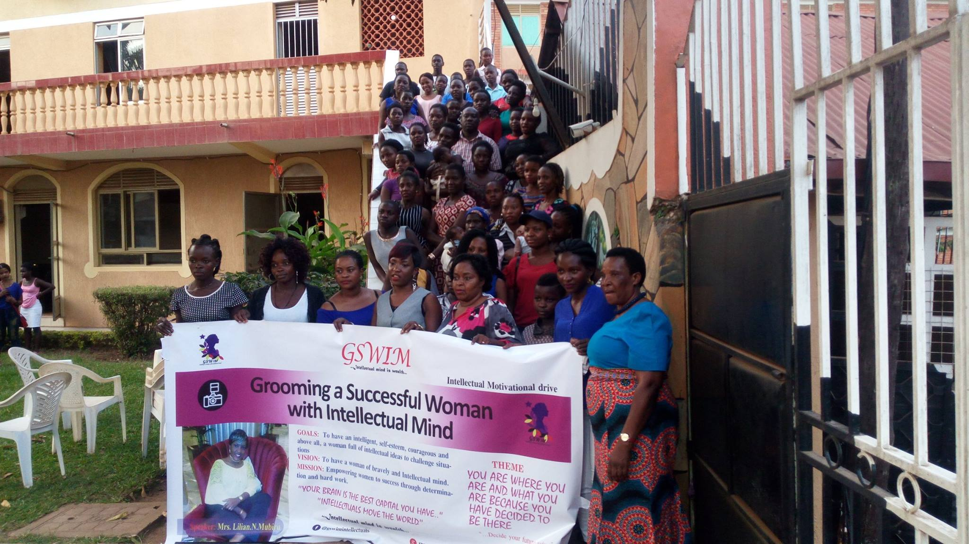
GSWIM’s launch as a women empowerment drive:
1st day of gswim at jokas hotel bweyogere
Second GSWIM meeting on changing women’s mind set towards growth

Slide 11
First GSWIM Project from WIPO/SIDA & PRV
Some of the Project commentators and supervisors from WIPO, SIDA and PRV
One of the project activity of growing women using Intellectual Property knowledge: Field visit to Provide equip offices

Slide 12
GSWIM/PRV/SIDA & WIPO project on using Intellectual Property as a tool for growth and development to women in Uganda.
GSWIM PRV/SIDA & WIPO Training
Some of the Project participants at UPRS Offices

Slide 13
Other GSWIM empowerment activities & learning opportunities about being creative and innovative to women:
GSWIM Trainings ON being creative and innovative for growth & development
Online courses on Intellectual Property for knowledge acquisition to women

Slide 14
Other GSWIM training activities and investment club for women:
Training activity on thinking big when investing and starting with what you have to grow big
GSWIM Women investment club:

Slide 15
GSWIM collaboration with other women foundations in empowering women with the Intellectual Property knowledge to improve on their well being through creativity:
Collaboration with the Guardian Angel Foundation for young mothers
Empowering Women IN the slum areas OF Namuwongo with business knowledge

Slide 16
GSWIM empowerment trainings in schools: Empowering the Girl child to live a creative life and have a bright future:
GSWIM visit to Kijabijjo Primary School: EMPOWERING A GIRL CHILD
Equipping a girl child with knowledge on how to make WASHABLE sanitary towels

Slide 17
Some of the GSWIM Charity activities in schools:
GSWIM giving out scholastic materials to a girl child in schools:
GSWIM collaborating with other charity organizations to support the vulnerable children in karamoja region

Slide 18
GSWIM Trainings to women on how to be creative and innovative in a very unique way for a competitive advantage over the market.
GSWIM trainers and a team of Exodus women who deal in artistic products.
Some of the outputs of the Exodus women and their uniqueness.

Slide 19
One of the GSWIM Training activity at Grand Imperial Hotel Kampala in 2019
Training workshop on “Idea to business development towards Brand Building” Women in Business
A team of participants and Facilitators

Slide 20
GSWIM December retreat on strategizing for the new year:
A training session during the retreat:
A team of participants and facilitators for 2019 December retreat:

Slide 21
GSWIM OFFICES:
OFFICE ADRESS:
OFFICE building:
Grooming a Successful Woman with Intellectual Mind
P.O Box, 33039,
Kampala, Uganda.
Plot No. 2428
Seeta, Namugogo road.
Email: gswim02@gmail.com
Website: www.gswim.org
Facebook: Grooming a Successful Woman with Intellectual Mind.

Slide 22
LAUNCHING OF GSWIM OFFICES ON 4th/July/2020 AFTER BEING TRANSFORMED INTO AN NGO TO EMPOWER WOMEN IN THE COMMUNITY.
Guest speakers from central gov’t & local gov’t.
Zoom presentations

Slide 23
Since the launch of the offices, GSWIM has carried out a number of empowerment trainings to needy women from different communities.

Slide 24
Empowering women in the community

Slide 25
Enhancing and supporting creative minds in rural areas

Slide 26
Skilling women with the creative knowledge

Slide 27
Empowering women for a mindset change
Business support to women
Girl child empowerment

Slide 28
Training needy women on the use of IP for business growth

